Slide 1


Alejandro
04/04/2023

Slide 2

Outline
Executive Summary
Introduction
Methodology
Results
Conclusion
Appendix

Slide 3
Executive Summary
Summary of methodologies
• Data Gathering through web scraping and the SpaceX API;
• Initial Data Exploration (EDA), encompassing data manipulation, data visualization, and interactive visual analytics
• Machine Learning Predictions.
Summary of all results
• Valuable data was successfully obtained from public sources;
• EDA enabled the identification of the most relevant features for predicting successful launches;
• Machine Learning Predictions revealed the optimal model for determining crucial factors to guide this opportunity most effectively, using all gathered data.

Slide 4
Introduction
Project background and context
The goal is to assess the potential of new company Space Y in competing with Space X.
• Desired outcomes:
The most effective method for estimating total launch costs by forecasting successful first-stage rocket landings;
The ideal location for conducting launches.

Slide 5

Section 1

Slide 6
Methodology
Executive Summary
Data collection methodology:
Data from Space X was sourced from two places:
Space X API (https://api.spacexdata.com/v4/rockets/)
WebScraping(https://en.wikipedia.org/wiki/List_of_Falcon/_9/_and_Falcon_Heavy_launches)
Perform data wrangling
The collected data was enhanced by generating a landing outcome label based on outcome data following feature summarization and analysis
Perform exploratory data analysis (EDA) using visualization and SQL
Perform interactive visual analytics using Folium and Plotly Dash
Perform predictive analysis using classification models
The collected data was enhanced by generating a landing outcome label based on outcome data following feature summarization and analysis

Slide 7
Data Collection
Data sets were gathered from the Space X API (https://api.spacexdata.com/v4/rockets/)
And Wikipedia (https://en.wikipedia.org/wiki/List_of_Falcon/_9/_and_Falcon_Heavy_launches) using web scraping techniques.

Slide 8
Data Collection – SpaceX API
This API was employed following the adjacent flowchart, and the data was then stored.
Add the GitHub URL of the completed SpaceX API calls notebook (must include completed code cell and outcome cell), as an external reference and peer-review purpose
Access API and parse SpaceX launch information
Filter data to only incorporate Falcon 9 launches
Handle Missing Values

Slide 9
Data Collection – Scraping
Data from SpaceX launches can also be obtained from Wikipedia
Data are downloaded from Wikipedia according to the flowchart and then put into our dataset.
Add the GitHub URL of your completed data wrangling related notebooks, as an external reference and peer-review purpose
Request the Falcon9 Launch Wikipedia page
Extract all desired data names from the HTML table header
Create a new dataset with the HTML tables

Slide 10
Data Wrangling
Initially, some Preliminary Data Analysis (EDA) was conducted on the dataset.
• Next, summaries of launches per site, occurrences of each orbit, and occurrences of mission outcomes per orbit type were determined.
• Lastly, the landing outcome label was generated from the Outcome column.
Add the GitHub URL of your completed data wrangling related notebooks, as an external reference and peer-review purpose
EDA
Summaries
Landing outcome label

Slide 11
EDA with Data Visualization
Scatterplots and barplots were utilized to examine data, displaying the relationship between pairs of features:
Payload Mass X Flight Number, Launch Site X Flight Number, Launch Site X Payload Mass, Orbit and Flight Number, Payload and Orbit
Add the GitHub URL of your completed EDA with data visualization notebook, as an external reference and peer-review purpose

Slide 12
EDA with SQL
The following SQL queries were executed:
• Unique launch site names in the space mission;
• Top 5 launch sites with names starting with 'CCA’;
• Total payload mass carried by NASA-launched boosters (CRS);
• Average payload mass carried by the F9 v1.1 booster version;
• Date of the first successful ground pad landing outcome;
• Names of boosters with drone ship successes and payload masses between 4000 and 6000 kg;
• Total number of successful and failed mission outcomes;
• Names of booster versions carrying the maximum payload mass;
• Failed drone ship landing outcomes, their booster versions, and launch site names in 2015; and
• Ranking of landing outcome counts (e.g., Failure (drone ship) or Success (ground pad)) between 2010-06-04 and 2017-03-20.
Add the GitHub URL of your completed EDA with SQL notebook, as an external reference and peer-review purpose

Slide 13
Build an Interactive Map with Folium
Folium Maps employed markers, circles, lines, and marker clusters
• Markers represent points like launch sites
• Circles highlight areas around specific coordinates, such as NASA Johnson Space Center
• Marker clusters indicate groups of events at each coordinate, like launches at a launch site
• Lines denote distances between two coordinates.
Add the GitHub URL of your completed interactive map with Folium map, as an external reference and peer-review purpose

Slide 14
Build a Dashboard with Plotly Dash
• The following charts and plots were employed to visualize data
• Launch site percentages
• Payload range
• This combination facilitated a quick analysis of the relationship between payloads and launch sites, aiding in identifying the optimal launch location based on payloads.
Add the GitHub URL of your completed Plotly Dash lab, as an external reference and peer-review purpose

Slide 15
Predictive Analysis (Classification)
Four classification models were evaluated: logistic regression, support vector machine, decision tree, and k-nearest neighbors.
Add the GitHub URL of your completed predictive analysis lab, as an external reference and peer-review purpose
Data preparation and standardization
Test of each model with combinations of hyperparameters
Comparison of results

Slide 16
Results
Preliminary data analysis findings:
• Space X utilizes 4 distinct launch sites;
• Initial launches were conducted for Space X itself and NASA;
• The average payload of the F9 v1.1 booster is 2,928 kg;
• The first successful landing outcome occurred in 2015, five years after the first launch;
• Several Falcon 9 booster versions successfully landed on drone ships with payloads above the average;
• Nearly 100% of mission outcomes were successful;
• Two booster versions failed to land on drone ships in 2015: F9 v1.1 B1012 and F9 v1.1 B1015;
• The number of successful landing outcomes increased over the years.

Slide 17

Section 2

Slide 18
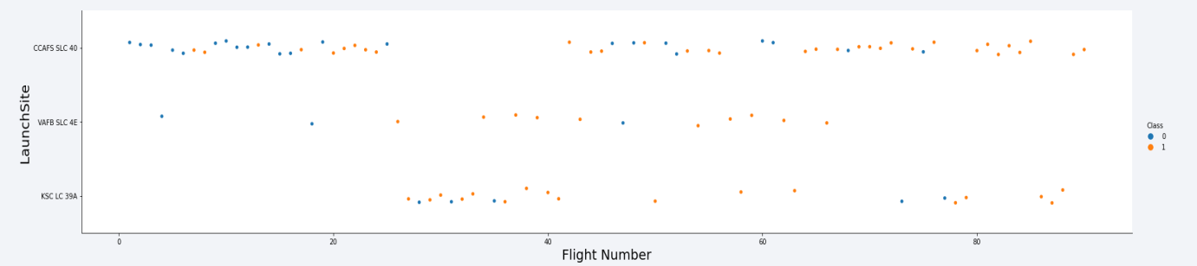
Flight Number vs. Launch Site
Based on the plot above, it can be observed that the current best launch site is CCAFS SLC 40, where most recent launches have been successful;
• VAFB SLC 4E ranks second, followed by KSC LC 39A in third place;
• The overall success rate has improved over time.

Slide 19
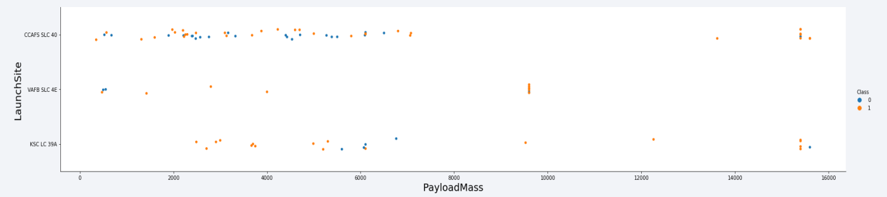
Payload vs. Launch Site
Payloads above 9,000 kg (approximately the weight of a school bus) exhibit a high success rate;
• Payloads exceeding 12,000 kg seem feasible only at CCAFS SLC 40 and KSC LC 39A launch sites.

Slide 20
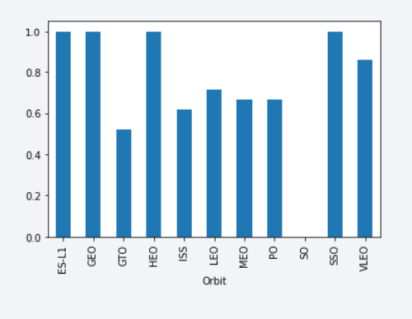
Success Rate vs. Orbit Type
• The highest success rates are associated with orbits:
• ES-L1
• GEO
• HEO
• SSO.
•Next in line are:
• VLEO (over 80%)
• LFO (over 70%)

Slide 21
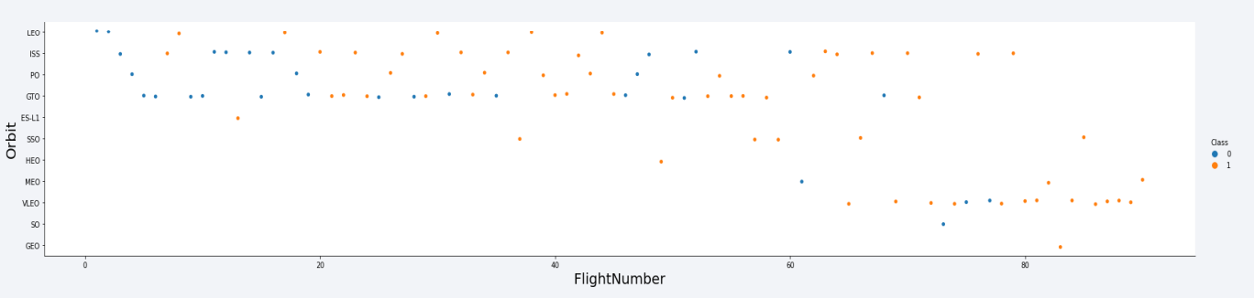
Flight Number vs. Orbit Type
Success rate seems to have improved over time for all orbits;
• The VLEO orbit appears to be a new business opportunity due to its recent increase in frequency

Slide 22
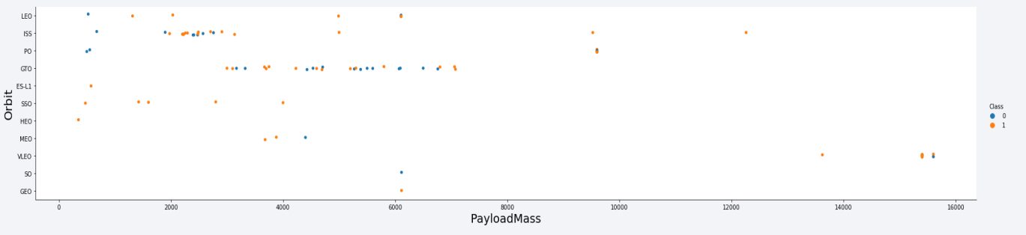
Payload vs. Orbit Type
There doesn't seem to be a correlation between payload and success rate for GTO orbit;
ISS orbit has the broadest payload range and a solid success rate;
Only a few launches target SO and GEO orbits.

Slide 23
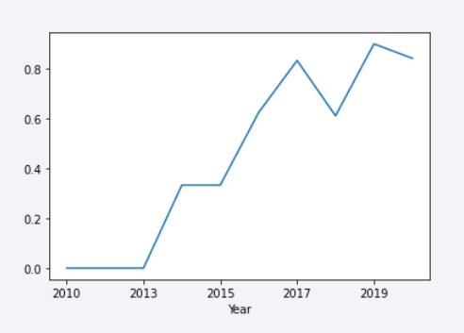
Launch Success Yearly Trend
• The success rate began to rise in 2013 and continued through 2020;
• The first three years seem to have been a period of adjustments and technological advancements.

Slide 24
All Launch Site Names
• The data reveals four launch sites:
CCAFS LC-40
CCAFS SLC-40
KSC LC-39A
VAFB SLC-4E
• These are acquired by selecting unique instances of "launch_site" values from the dataset.

Slide 25
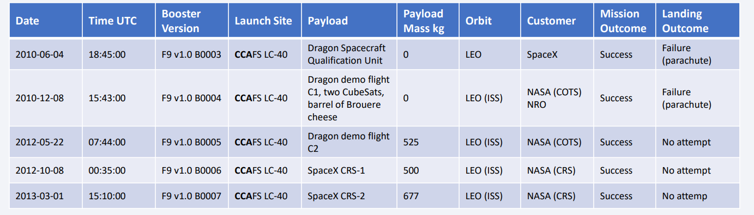
Launch Site Names Begin with 'CCA'
Find 5 records where launch sites begin with `CCA`
In this query, we can see five examples of Cape Canaveral launches.

Slide 26
Total Payload Mass
Calculate the total payload carried by boosters from NASA
Total Payload (kg)
111.268
The total payload calculated is obtained by adding all payloads with codes containing 'CRS,' which corresponds to NASA.

Slide 27
Average Payload Mass by F9 v1.1
Average payload mass carried by booster version F9 v1.1
Avg Payload (kg)
2.928
• By filtering data for the booster version F9 v1.1 and calculating the average payload mass, we get the value of 2,928 kg.

Slide 28
First Successful Ground Landing Date
Find the dates of the first successful landing outcome on ground pad
Min Date 2015-12-22
By filtering data for successful ground landing outcomes and finding the earliest date, we identify the first occurrence on December 22, 2015.

Slide 29
Successful Drone Ship Landing with Payload between 4000 and 6000
List the names of boosters which have successfully landed on drone ship and had payload mass greater than 4000 but less than 6000
Booster Version
F9 FT B1021.2
F9 FT B1031.2
F9 FT B1022
F9 FT B1026
Selecting distinct booster versions based on the filters, the following four results are obtained.

Slide 30
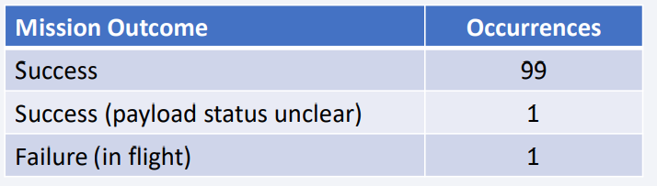
Total Number of Successful and Failure Mission Outcomes
Calculate the total number of successful and failure mission outcomes
Grouping mission outcomes and counting records for each group produces the summary below.

Slide 31
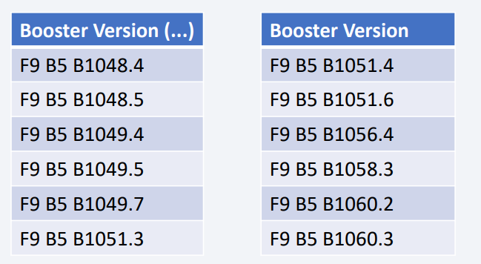
Boosters Carried Maximum Payload
List the names of the booster which have carried the maximum payload mass
The following boosters have carried the maximum payload mass recorded in the dataset.

Slide 32
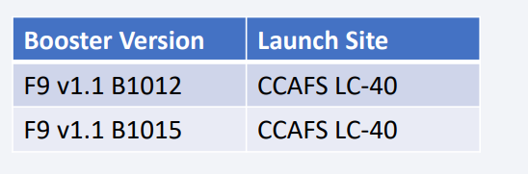
2015 Launch Records
List the failed landing_outcomes in drone ship, their booster versions, and launch site names for in year 2015

Slide 33
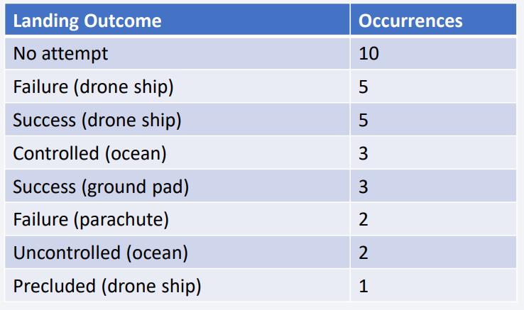
Rank Landing Outcomes Between 2010-06-04 and 2017-03-20
Rank the count of landing outcomes (such as Failure (drone ship) or Success (ground pad)) between the date 2010-06-04 and 2017-03-20, in descending order
We see that ‘No attempt’ has 10 occurrences

Slide 34

Section 3

Slide 35
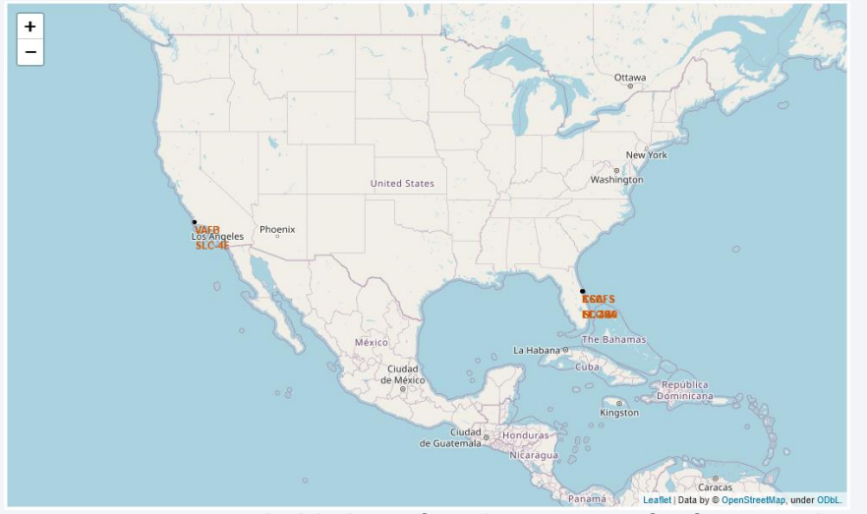
Launch sites
Launch sites are typically situated near the sea, likely for safety reasons, but also remain in proximity to roads and railroads.

Slide 36
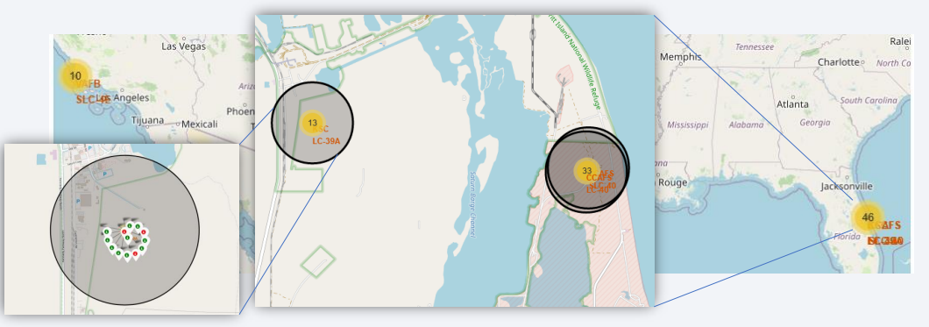
Launch Outcomes
An example of launch outcomes at the KSC LC-39A site
• Green markers represent successful launches, while red ones indicate failures.

Slide 37
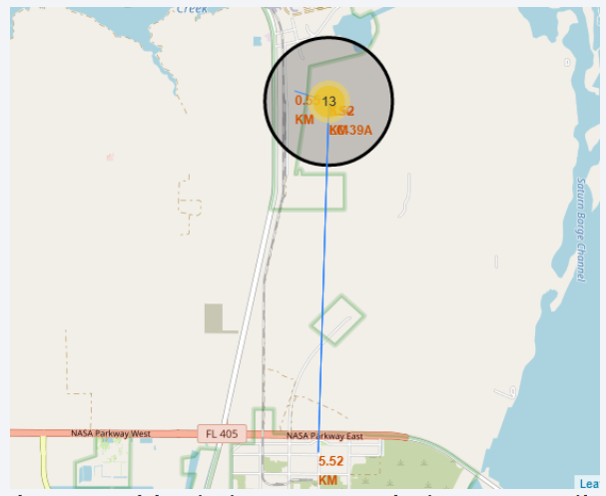
Launch site characteristics
• The KSC LC-39A launch site exhibits good logistical aspects, being close to railroads and roads while remaining relatively distant from populated areas.

Slide 38

Section 4

Slide 39
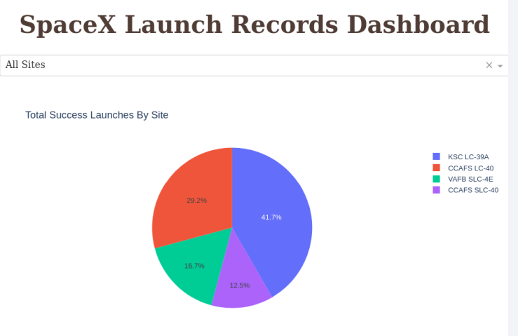
Launch Success
The location from which launches are conducted appears to be a crucial factor in mission success.

Slide 40
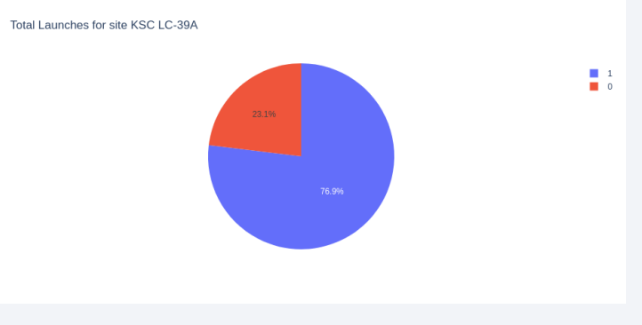
KSC LC-39A Success Ratio
Almost 77% of launches are successful

Slide 41
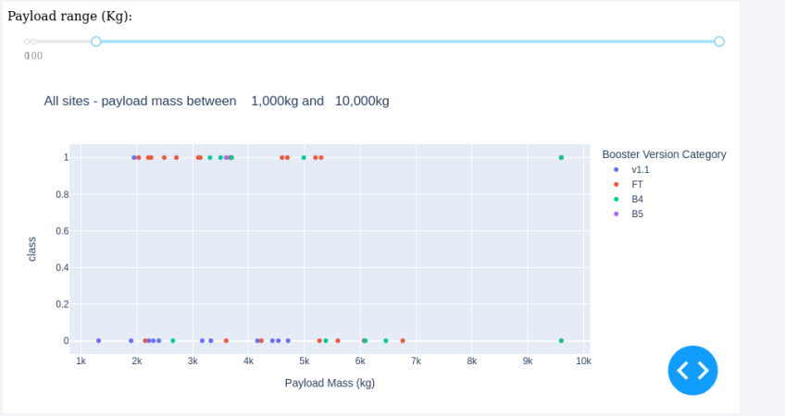
Payload vs Launch Outcome
Explain the important elements and findings on the screenshot, such as which payload range or booster version have the largest success rate, etc.

Slide 42

Section 5

Slide 43
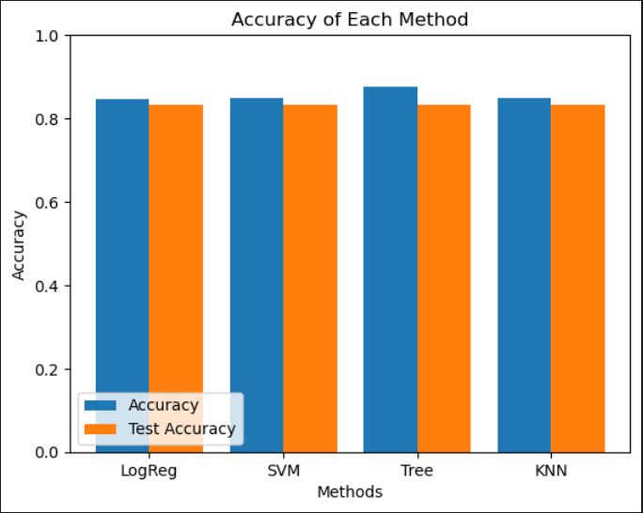
Classification Accuracy
• Four classification models were tested,
and their accuracies are plotted here
• All models yield the same test accuracy, roughly 84%

Slide 44
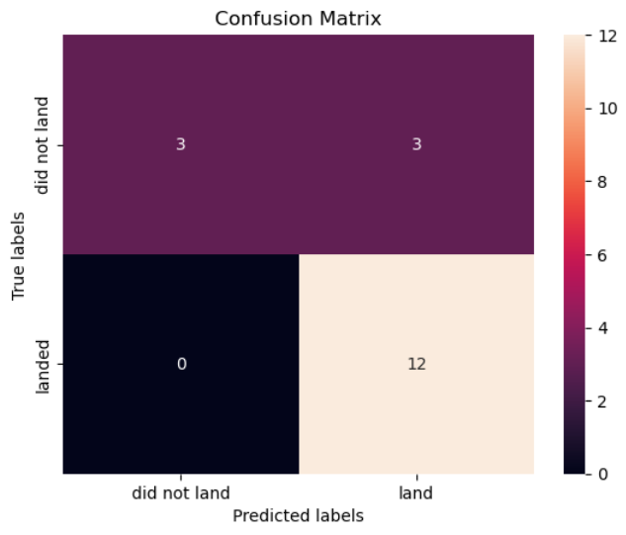
Confusion Matrix
The model misclassifies half of the landings that didn’t actually land

Slide 45
Conclusions
From this study we can deduct:
• Launches above 7,000 kg are less risky
• The optimal launch site is KSC LC-39A
• Decision Tree Classifier can be utilized to predict successful landings and enhance profits
• While most mission outcomes are successful, successful landing outcomes appear to improve over time due to advancements in processes and rocket technology
• Various data sources were examined, with conclusions being refined throughout the process.

Slide 46
Appendix

Slide 47


